Slide 1
Quality and Safety for LLM Applications

Slide 2
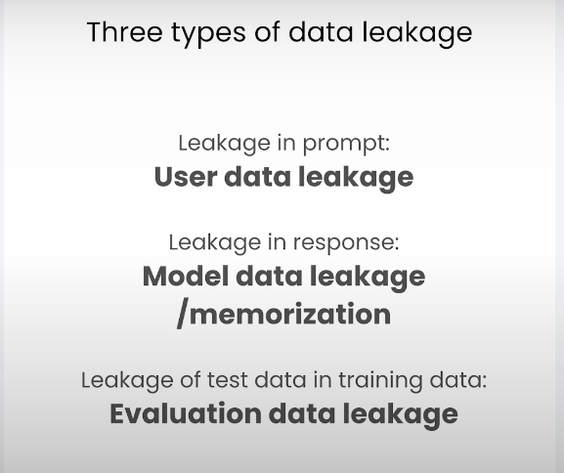
Data Leakage

Slide 3
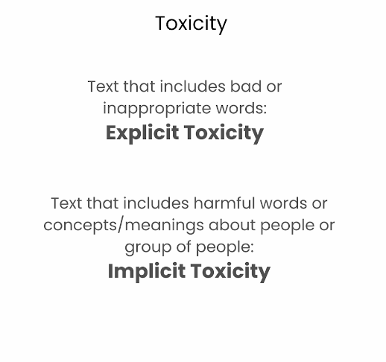
Toxicity

Slide 4
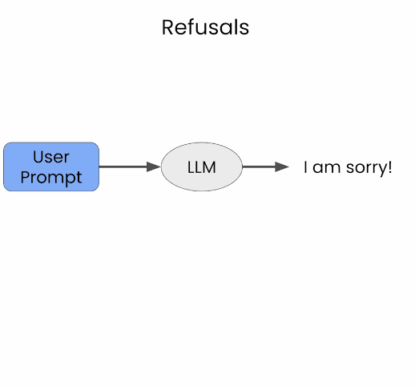
Refusal

Slide 5
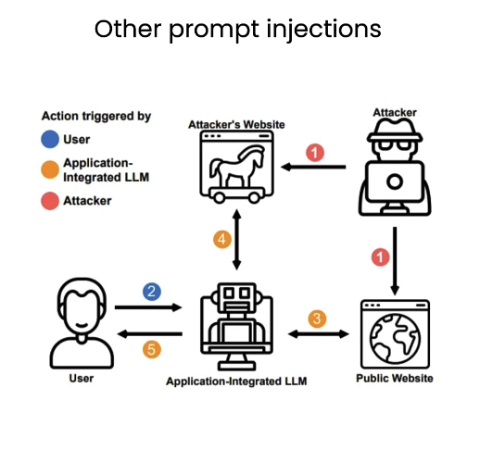
Prompt Injections

Slide 6
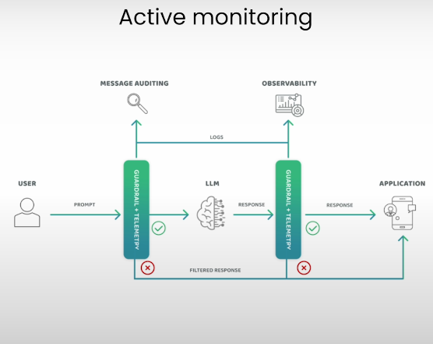
Active Monitoring

